Slide 1

Data Visualization

Slide 2
Rocket Launch Compare By Company
[Source: Rocketry Today, 2021]

Slide 3
What Americans think about economic trends？
44% Americans think the economy is shrinking, 21% American think the economy is Staying the same, 20% American think the economy is Growing and 15% American is not sure.
In conclusion, most of American think the economic trend of the US is Shrinking.

Slide 4
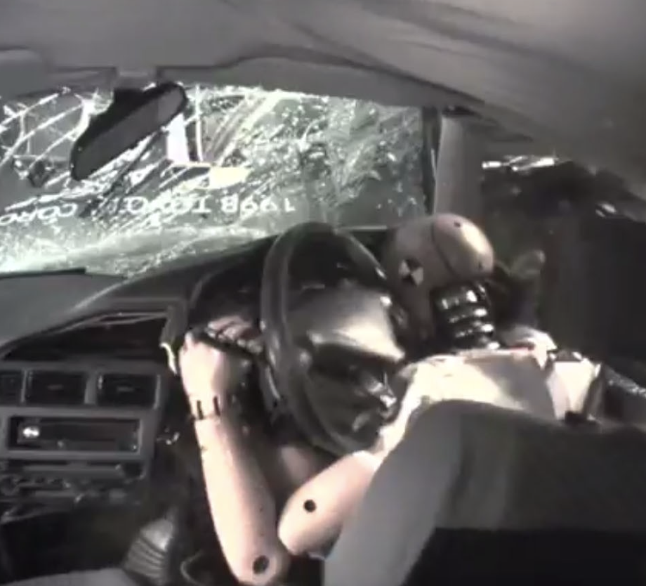

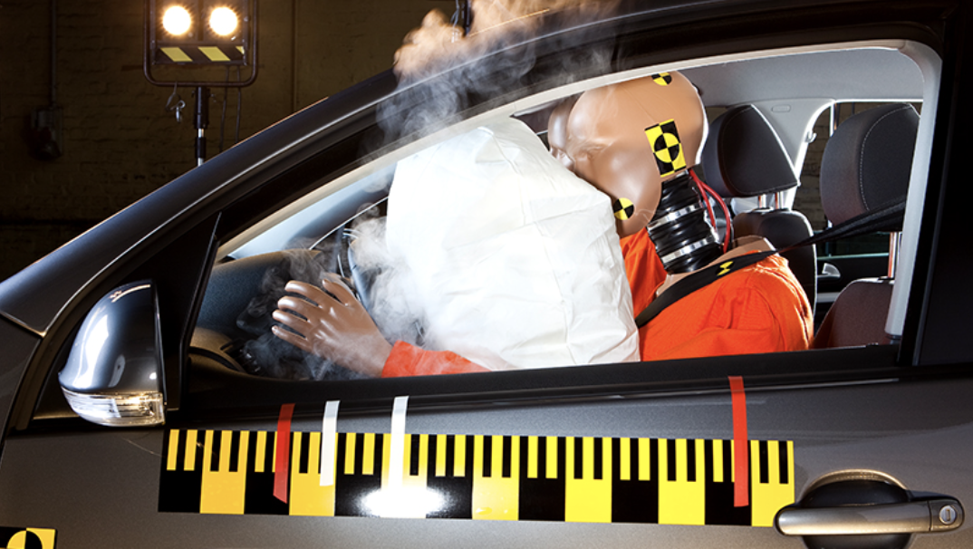
Air Bags will Reduce automobile fatalities
air bags will decrease in automobile fatalities
Without Airbag
With Airbag

Slide 5
CO Emissions
[Source: UC Riverside Marlan and Rosemary Bourns College of Engineering]

Slide 6
The United States Global share has increased since 2011
Changes in U.S. share of global oil production over a decade(2011 to 2021).
Increase from 11% to 13%.
[Sources: World Population Review (2022), energy.gov (2012)

Slide 7
Thank you

